Slide 1

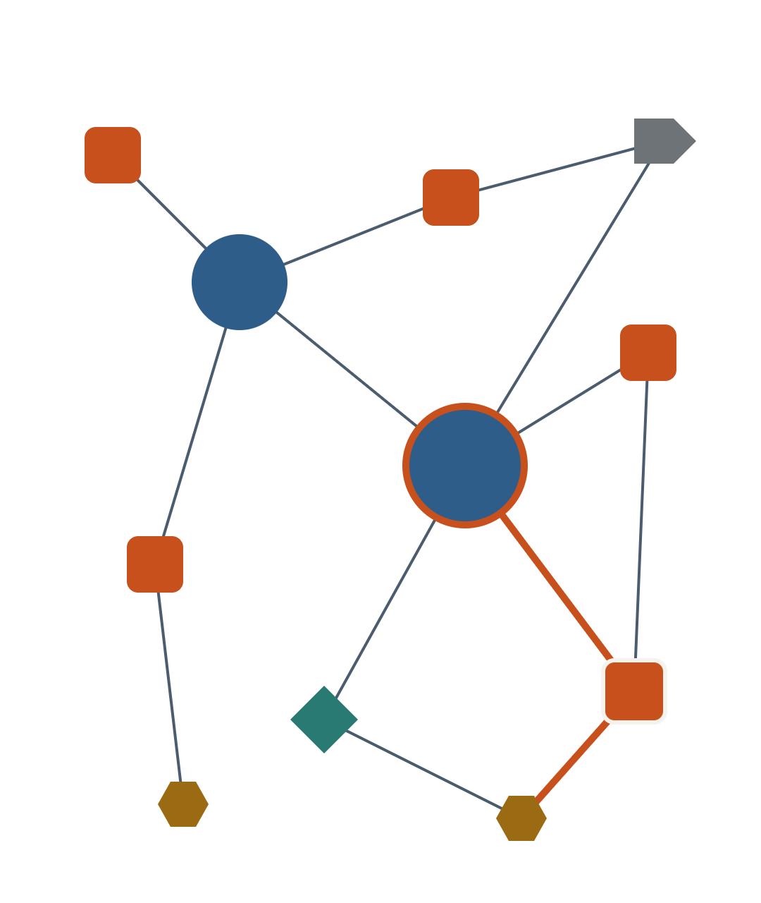
clausemap
See the whole deal.
Cite every line.
Clausemap turns a contract into a map of who owes what to whom, by when. Every line on it is quoted verbatim from the page it came from.
IBM Bob 2.0 hackathon · September 2026
Notes:
Open on the tagline. One sentence: Clausemap reads a contract and maps who owes what to whom, by when, and every item on the map opens the exact sentence and page it came from.

Slide 2
A 30-page agreement takes an hour to read, and you can't cite a summary.
01
02
03
Slow
Flat
Uncitable
Reading front to back takes about an hour before the real review can start.
A plain summary loses the structure: who owes what, to whom, by when.
A reviewer has to point to the clause. A summary gives them nothing to point to.
clausemap
02
Notes:
Our users are analysts in due diligence, contract review, compliance and consulting. A new 30-page agreement lands: they need the parties, what each one owes, and the key dates and amounts before the real review. Reading it takes an hour, a summary loses the structure, and you can't cite a summary.

Slide 3
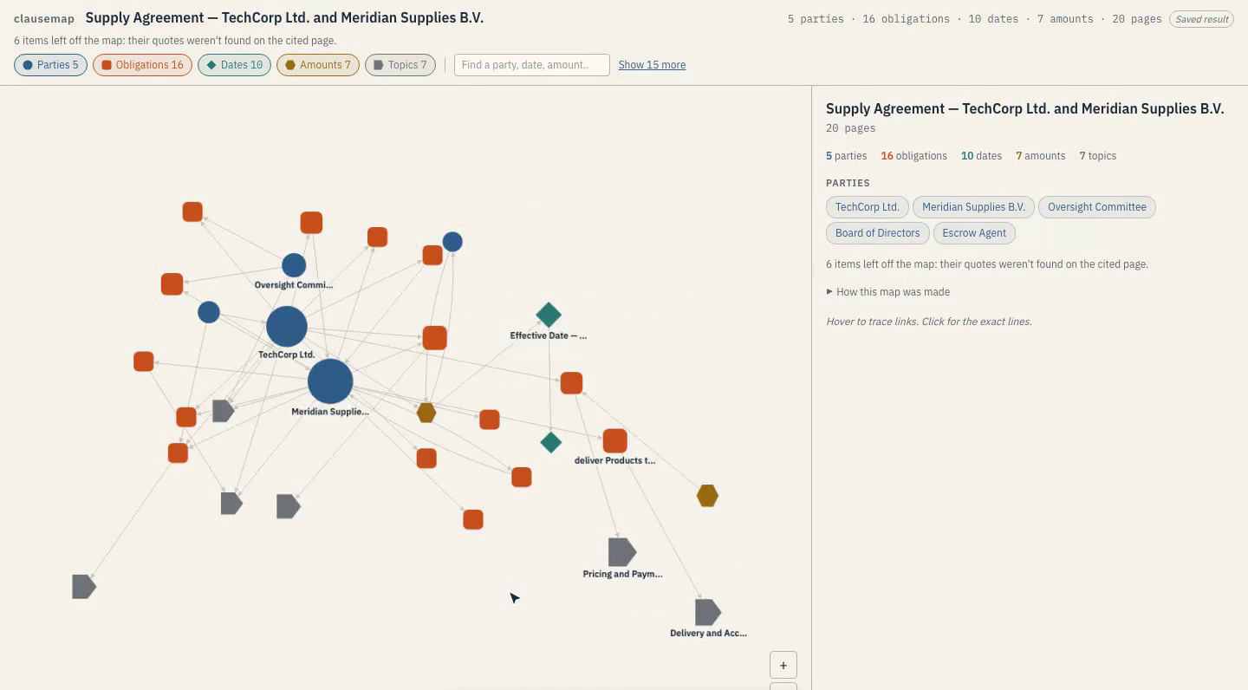





Upload a contract. Get a map of who owes what to whom, by when.
Party who
Obligation owes what
Date by when
Amount how much
Topic where in the deal
Demo: a 20-page supply agreement, 45 items and 60 links. The overview opens with the 30 most connected items and every party; one click shows the rest.
clausemap
03
Notes:
Drop in a text-based PDF, or open a demo. Clausemap lays out every party, obligation, date, amount and topic as one network. Types differ by shape as well as colour. Big documents open as an overview, and "Show 15 more" expands to everything.

Slide 4
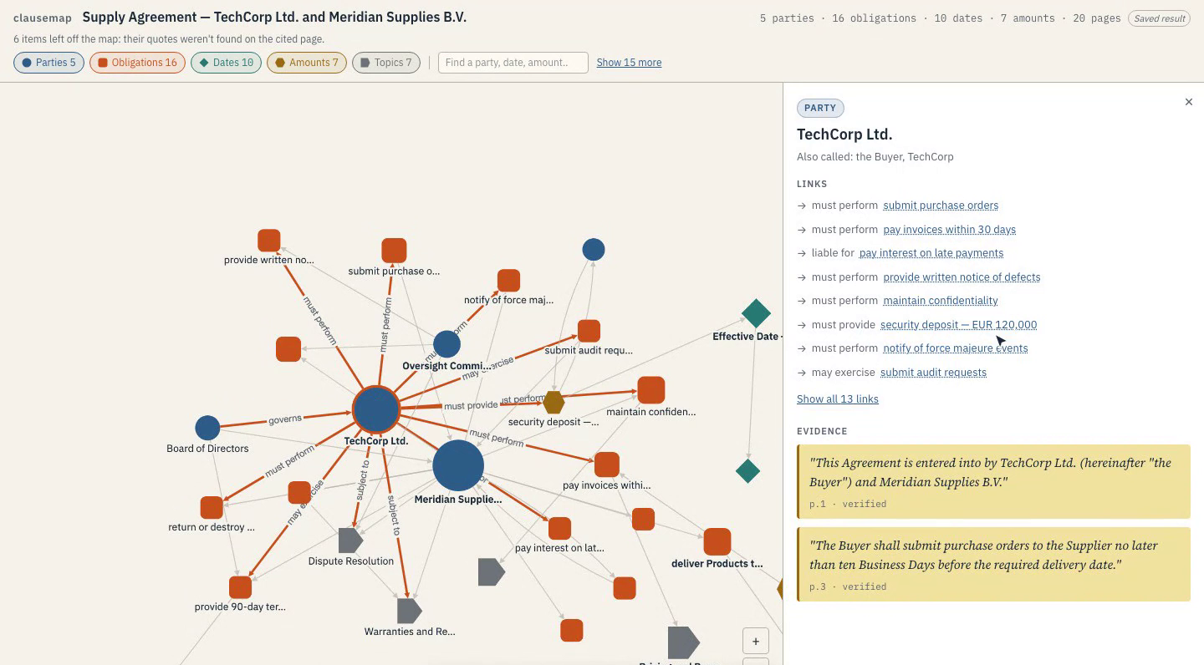
Click anything. See the exact line.
“The Buyer shall submit purchase orders to the Supplier no later than ten Business Days before the required delivery date.”
p. 3 · verified
Every node and every link carries its quote and page.
Links read as sentences: must perform, liable for, may exercise.
clausemap
04
Notes:
Click TechCorp Ltd.: the panel shows its other names (the Buyer, TechCorp), its 13 links, and the sentences behind them, each with a page number and "verified". Click a linked obligation, such as "pay invoices within 30 days", to jump along the chain.

Slide 5
From PDF to map in four checked steps
Read
The PDF is split into pages, so every item keeps its page number.
0.0 s
20 pages
Extract
One call per page finds parties, obligations, dates and amounts, with quotes.
1.2–22.1 s
1 call / page
Verify
Each quote is matched word for word against its page. No match, no node.
34.2 s
6 dropped
Merge
“TechCorp Ltd.”, “TechCorp” and “the Buyer” become one party, then the graph is drawn.
36.8 s
52 → 45 nodes
Timings from the demo run: a 20-page supply agreement, mapped in 36.8 s into 45 nodes and 60 links.
clausemap
05
Notes:
This is the "How this map was made" log from the app, shown to every user. Pages are the unit of work, so extraction runs in parallel. The verify step is what makes the map citable: a quote the model paraphrased or invented never reaches the map. Merging handles defined terms, so one company isn't three nodes.

Slide 6
VERBATIM OR NOTHING
6 items left off the map.
Their quotes weren't found on the cited page, so Clausemap dropped them and says so. A citation that isn't in the document is worse than no tool at all.
Notes:
This line sits at the top of every map. Most AI tools hide what they couldn't verify. We show it, because the analyst's reputation rides on every quote they cite.

Slide 7
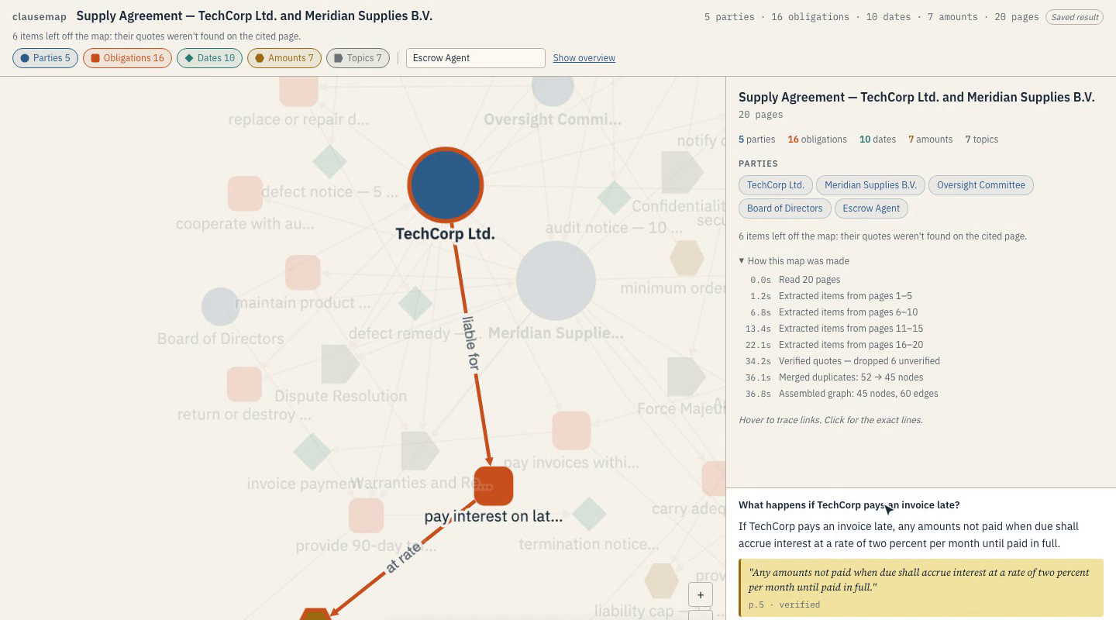
Ask a question, get the clause.
QUESTION
What happens if TechCorp pays an invoice late?
“Any amounts not paid when due shall accrue interest at a rate of two percent per month until paid in full.”
p. 5 · verified
The answer's path lights up on the map: TechCorp → liable for → pay interest → at rate → late payment interest.
clausemap
07
Notes:
Beyond the overview: filter by type (only parties and obligations, say), search by name (Escrow Agent), zoom and pan, and ask in plain English. Answers are grounded in the text: the quote and page come with it, and the relevant part of the map lights up.

Slide 8
Why not NotebookLM?
 | NotebookLM mind map | Clausemap
Maps | Topics and subtopics | Parties, obligations, dates, amounts
Links | Topic to subtopic | Typed: must perform, liable for, due by
Evidence | Citations in chat answers | A verified quote and page on every node and link
NotebookLM maps topics. Clausemap maps obligations, and every line on it is quoted verbatim.
clausemap
08
Notes:
The judges will ask. NotebookLM already turns sources into a clickable mind map with cited answers, for free. The difference: we map relations between parties with a verified quote on every link, not a hierarchy of topics. Check NotebookLM's current features right before presenting; they change often.

Slide 9
Who pays, and why
BUYER
THE JOB
PRICING
Review teams
The first pass
Per seat
Due diligence, contract review, legal ops and consulting: people who must be right and prove it.
Parties, obligations, deadlines and amounts for every incoming agreement, with citations ready for the memo.
[€__] per seat per month. Team plan with EU hosting at [€__] per seat.
Land with the first pass. Expand with contract version comparison and export to a review memo.
clausemap
09
Notes:
Lead buyer: due-diligence and contract-review teams. They review many agreements a week, and the first pass is repetitive, billable time. Per-seat pricing matches how they buy tools. The expansion features, comparing two contract versions and exporting the map with its quotes into a review memo, are what turn it into part of the deliverable.

Slide 10
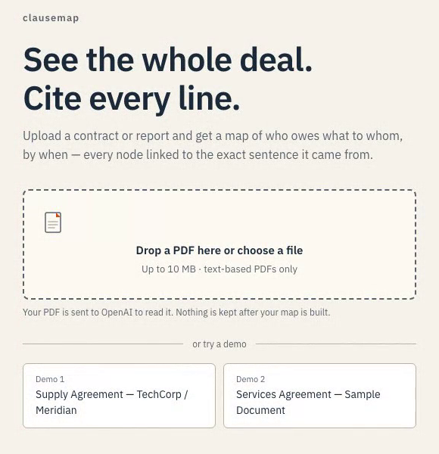
Where does the document go?
Nothing is kept
Documents are processed for the map, then discarded. Nothing is kept after it's built.
The provider is named
The upload screen says where the text goes: “Your PDF is sent to OpenAI to read it.”
A map, not a verdict
Every map says it isn't legal advice, and never claims to have found every obligation.
clausemap
10
Notes:
Confidentiality is the buyer's first question, and their security team's deal-breaker. Today: nothing stored, the model provider named on the upload screen, API keys on the server only, and a not-legal-advice line on every map. For regulated buyers, EU processing and a self-hosted option are on the roadmap.

Slide 11
What's built, and what comes next
BUILT TODAY
BEFORE A PILOT
LATER
Text PDFs up to 10 MB
Five item types, typed links
Every quote verified on its page
Duplicates merged
Filter, search, overview
Questions answered with sources
Scanned PDFs (OCR)
Background jobs for long files
Export to a review memo
EU data processing
Compare two contract versions
Self-hosted option
Smarter merging with human review
clausemap
11
Notes:
Honest about limits: today it reads text-based PDFs only, and requests run synchronously, which is fine for a demo but not for a team. Before a pilot: OCR, a job queue, export and EU processing. Comparing two versions of a contract is the feature a due-diligence team would pay for first.

Slide 12
Built in a day with IBM Bob
Two developers worked in parallel against one frozen JSON contract: one on the pipeline, one on the map.
[Bob screenshot: extraction]
[Bob screenshot: verification]
Extraction, quote verification, merging and the map UI were each built in IBM Bob sessions.
TEAM
[Bob screenshot: merging]
[Bob screenshot: map UI]
Setare [role]
[Teammate] [role]
clausemap
12
Notes:
Replace the four boxes with screenshots from the Bob sessions (check each one for API keys first). Say in one sentence what Bob did best in each.

Slide 13
clausemap
See the whole deal.
Cite every line.
TRY IT
CODE
[demo URL]
[repo URL]
Notes:
Close on the tagline and the live link. The two demos open instantly, no login.

